Slide 1
Flood Detection and Prevention System using ESP 32
Floods are a type of natural calamity that can seriously harm both persons and property.
Early flood detection and prompt response are essential for minimising their effects.

Slide 2
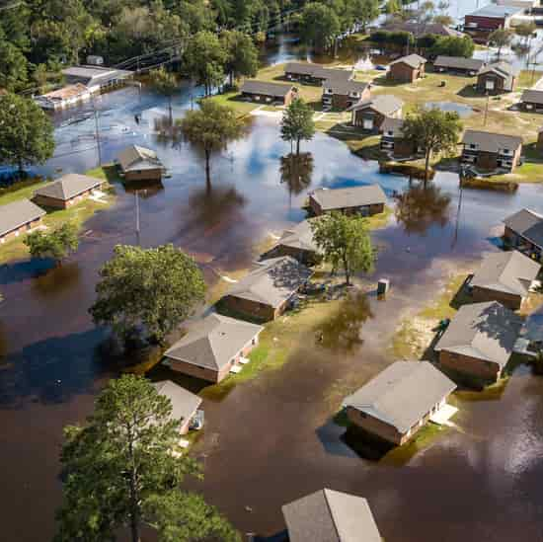
Introduction
A real-time data collection and analysis system
Monitors water levels, rainfall, and other factors
Provides early warnings of potential floods
Helps mitigate flood damage and save lives
The system uses ultrasonic sensors to determine the depth of the water.
ESP-32 to store and analyze sensor data.
ESP32 Wi-Fi connectivity to transfer the data which is gathered by the sensors to the ESP-32.

Slide 3

System Benefits
Early Warning Systems
Provides time for evacuation and protective measures
Reduces risk of loss of life and injury
Improved Decision Making
Real-time data allows for informed decisions
Enables targeted resource allocation during emergencies
Flood Mitigation Strategies
Long-term data helps identify flood-prone areas
Supports infrastructure development and flood plain management

Slide 4

The Future of Flood Monitoring
Integration with advanced technologies
Drones for aerial surveillance and real-time mapping
Artificial intelligence for enhanced data analysis and prediction
Integration with existing emergency response systems
Community Preparedness Initiatives
Public education and awareness campaigns
Flood plan development and evacuation drills
Collaboration with local authorities and stakeholders

Slide 5

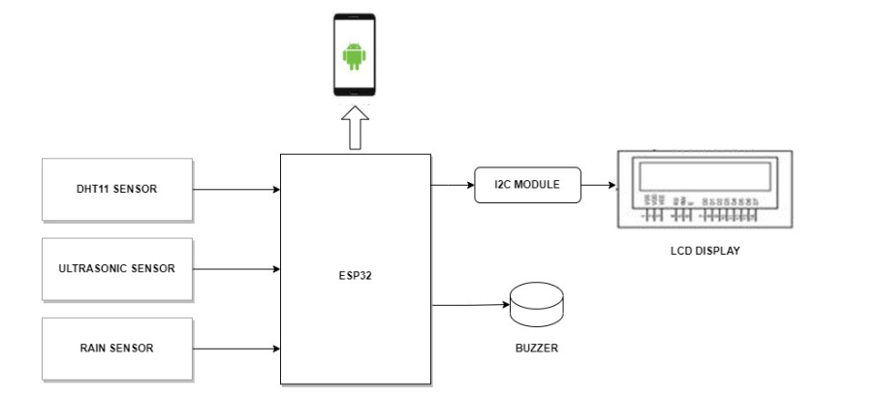
Hardware Description
The system's main element, the ESP 32, is utilised to gather and process data from the sensors. It is a cheap, compact computer that is simple to combine with other hardware elements like sensors.
1. ESP 32 (any model)
2. Ultrasonic sensor (HC-SR04)
3. Rain sensor
4. LED (3) (any color)
5. LCD (16x2 or 20x4)
6. DHT11 sensor (temperature and humidity sensor)
7. Breadboard or PCB for circuit connections
8. Jumper wires for connecting components

Slide 6

Web application
This will display the real time data on thingspeak and provide alerts to users when the water levels reach a critical level. The web application will be accessible from any device with an internet connection.

Slide 7
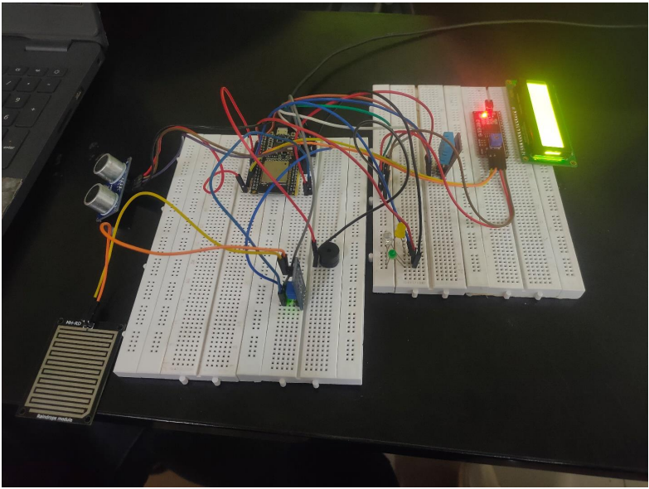
result

Slide 8

Conclusion
Flood monitoring systems play a vital role in protecting lives and property.
Real-time data and early warnings enable proactive measures.
Continuous development and community engagement are essential.

